Slide 1
Robot Kinematics
For Mobile Robots Localization

Slide 2
Conceptually..
Mobile Robot Kinematics is the dynamic model of how a mobile robot behaves
Kinematics is a description of mechanical behaviour of the robot for design and control
Mobile Robot Kinematics is used for:
Position estimation
Motion estimation

Slide 3
In theory..
Mobile robots move unbounded with respect to their environment
There is no direct way to measure robot position
Position must be integrated over time from velocity
The integration leads to inaccuracies in position and motion estimation
Each wheel contributes to the robot’s motion and imposes constraints on the robot’s motion
All of the constraints must be expressed with respect to the reference frame (global inertial frame)

Slide 4

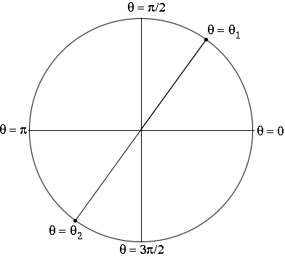
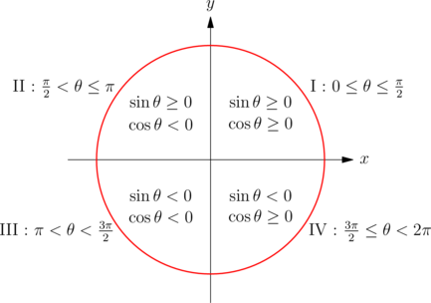
Turn angle/theta/

Slide 5
Forward and Inverse Kinematics
Forward Kinematics involves estimating a mobile robot’s motion and/or pose given the angular and linear velocity (find/estimate the coordinates when the variables turn angle and move distance are available)
Inverse Kinematics involves determining the robot’s angular and linear velocity to achieve a given robot motion and/or pose (find/estimate the variables turn angle and move distance when the coordinates are available)

Slide 6
Forward
Inverse
Given: turnAngle, moveDistance
Find: next position coordinates (target)
Issue: Robot can always turn and move but because of drift, robot will not arrive exactly at desired coordinate (target). How to get robot to arrive exactly at the new coordinates?
Given: next position coordinates (target)
Find: turnAngle, moveDistance
Issue: Now robot knows its next destination, and using matrix rotation calculation, robot can always derive the correct turn and move, but again, because of drift robot cannot arrive exactly at the new target..
Pose estimation error
How big of an issue robot drift is???
Robot drift is due to wheels behaviour highly dependent on motor balance (ac/dc → uneven velocity distribution → uneven calibration), reaction towards surface type (carpet/tile/bumps/ holes/etc). If pose error not fixed, pose cannot be used to build robot map (map will be distorted)

Slide 7

Robot Reference Frame (Global/Local)
The robot’s reference frame is three dimensional including position on the plane and the orientation, {XR, YR, }
The axes {XG, YG},define the inertial global reference frame with origin, O
The angular difference between the global and reference frames is
Point P on the robot chassis in the global reference frame is specified by coordinates (x, y)
The vector GPR below describes the location of the robot with respect to the inertial global reference frame.

Slide 8



Orthogonal Rotation Matrix
The orthogonal rotation matrix is used to map motion in the global reference frame {XG, YG} to motion in the robot’s local reference frame {XR, YR}
The orthogonal rotation matrix is used to convert robot velocity in the global reference frame {XG, YG} to components of motion along the robot’s local axes {XR, YR}
The vector PR describes the location of the robot with respect to the local reference frame.

Slide 9
Please use additional material as case study
Work out the robot’s kinematics

